Slide 1
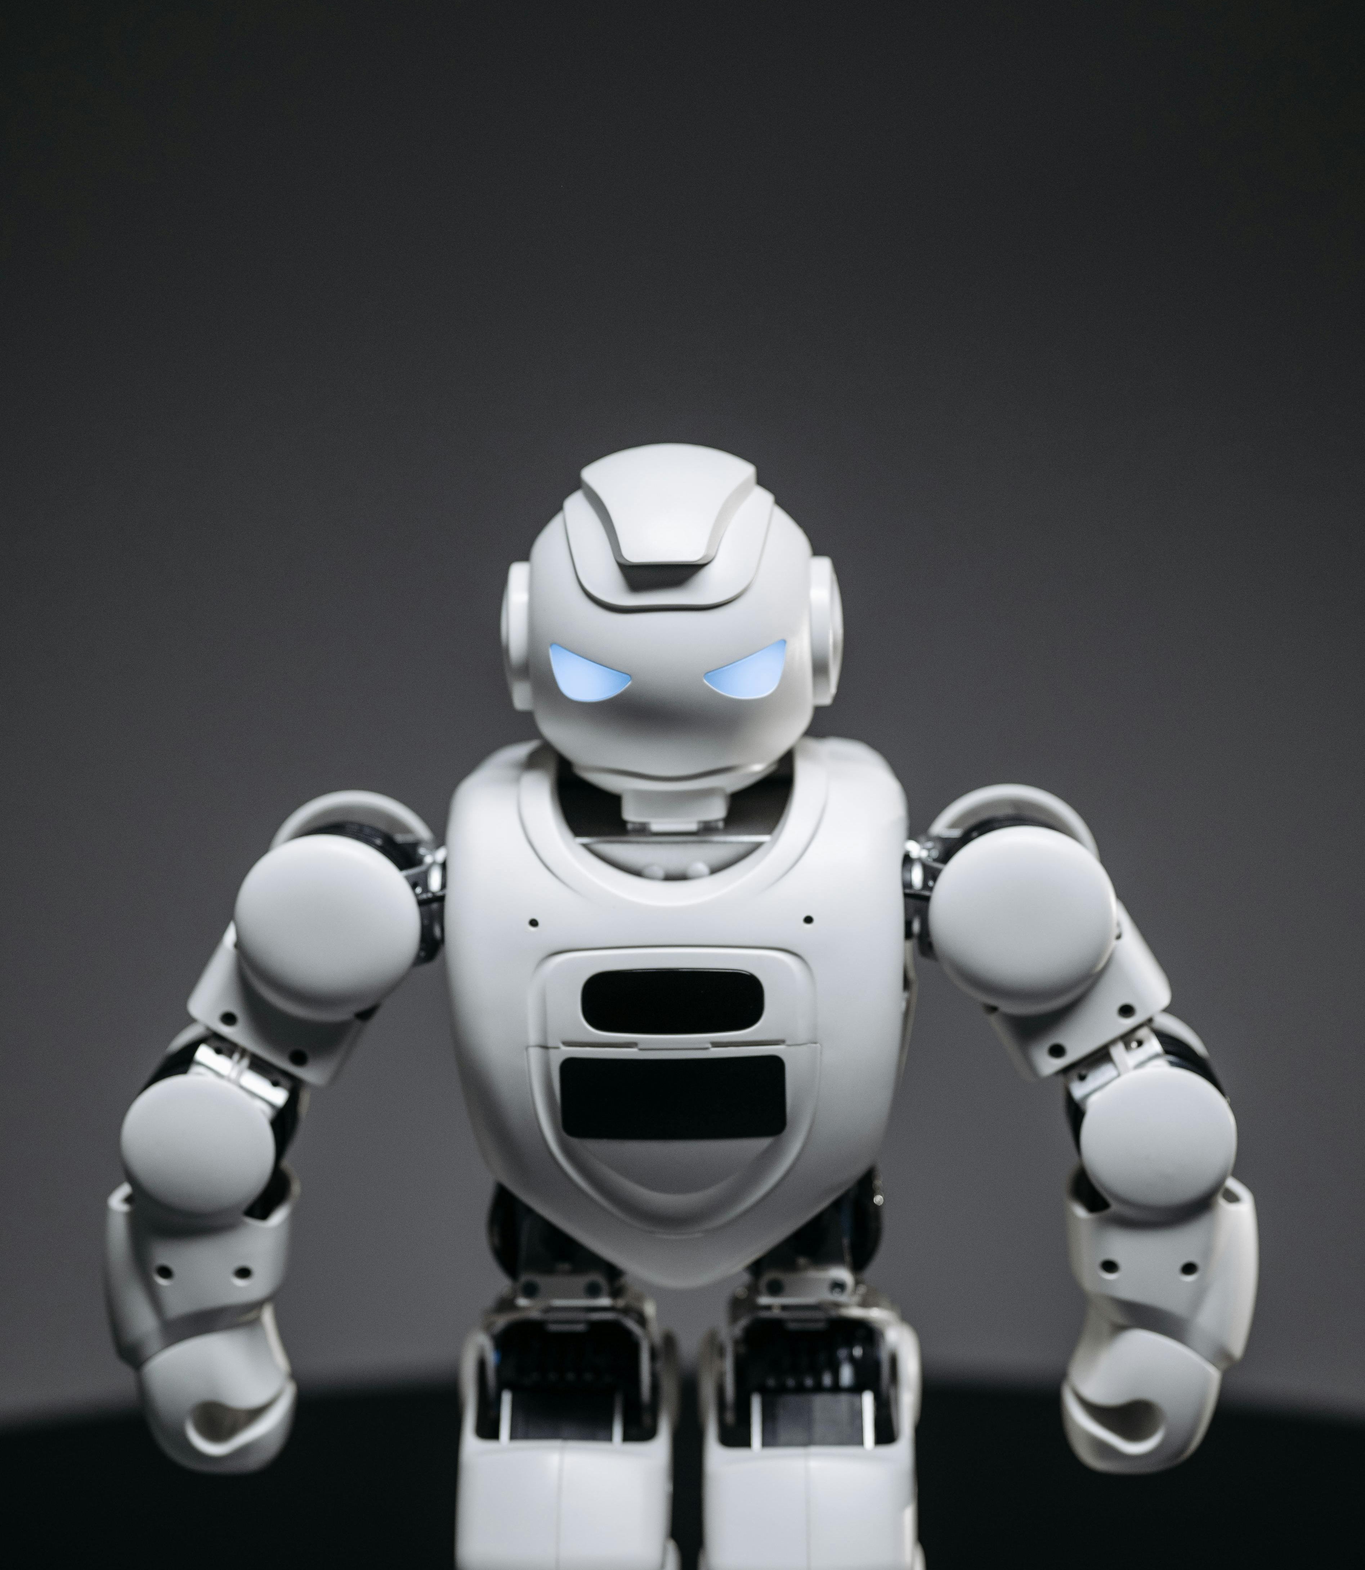
Running Your Own ChatGpt: Unlocking the Power of Local Large Language Models LLMs
Chris McCabe

Slide 2
Why run your own LLM?
Privacy
Flexibility
Uncensored or Configurable usage
Fun

Slide 3
Privacy
Data never leaves your machine
No Third-Party Exposure
Comply with Data Regulations

Slide 4
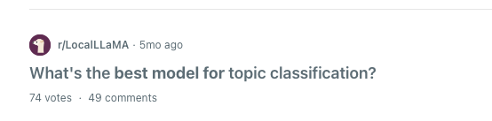

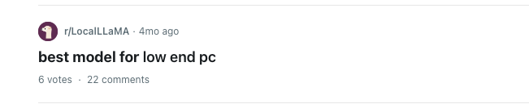



Flexibility - Different models

Slide 5
Flexibility of different models
{ 'model': 'hermes3:8b', 'time': 5.77803897857666, 'mappings': { 'data': [ { 'name': 'McApple', 'score': 1 }, { 'name': 'iFruit', 'score': 4 }, { 'name': "Steve's Apples", 'score': 3 }, { 'name': 'Big Apple Tech', 'score': 2 }, { 'name': 'Apple Inc.', 'score': 5 }, { 'name': "Newton's Rival", 'score': 2 }, { 'name': 'Green Apple Computers', 'score': 1 }, { 'name': 'The Red Delicious', 'score': 3 }, { 'name': 'Crisp Tech', 'score': 4 }, { 'name': "Granny's Smith", 'score': 2 } ] } },
{ 'apple': 10, 'Apple Inc.': 9, 'Apple Computer Inc.': 8, 'Apple Products Inc.': 7, 'Apple Technology Group': 6, 'Apple Technologies': 5, 'Apple Computer Corporation': 4, 'Apple Computer': 3, 'Apple Computer Co., Ltd.': 2, 'Apple Computer, Inc.': 1 }
'model': 'llama3.1:latest', 'time': 8.427261352539062, 'mappings': { 'Big Apple': 0.5, 'The Fruit Company': 0.2, 'iCompany': 0.8, 'Apple Inc.': 0.1, "Steve's Gadgets": 0.3, 'The Tech Giant': 0.6, 'New Apple': 0.4 } },
Generate a list of alternative names used for the organization '{organization_name}' with a score on how likely they are to be used. Return a list with keys using the keys `name` and `score`.

Slide 6
Flexibility of different models
{ 'model': 'hermes3:8b', 'time': 5.77803897857666, 'mappings': { 'data': [ { 'name': 'McApple', 'score': 1 }, { 'name': 'iFruit', 'score': 4 }, { 'name': "Steve's Apples", 'score': 3 }, { 'name': 'Big Apple Tech', 'score': 2 }, { 'name': 'Apple Inc.', 'score': 5 }, { 'name': "Newton's Rival", 'score': 2 }, { 'name': 'Green Apple Computers', 'score': 1 }, { 'name': 'The Red Delicious', 'score': 3 }, { 'name': 'Crisp Tech', 'score': 4 }, { 'name': "Granny's Smith", 'score': 2 } ] } },
{ 'apple': 10, 'Apple Inc.': 9, 'Apple Computer Inc.': 8, 'Apple Products Inc.': 7, 'Apple Technology Group': 6, 'Apple Technologies': 5, 'Apple Computer Corporation': 4, 'Apple Computer': 3, 'Apple Computer Co., Ltd.': 2, 'Apple Computer, Inc.': 1 }
'model': 'llama3.1:latest', 'time': 8.427261352539062, 'mappings': { 'Big Apple': 0.5, 'The Fruit Company': 0.2, 'iCompany': 0.8, 'Apple Inc.': 0.1, "Steve's Gadgets": 0.3, 'The Tech Giant': 0.6, 'New Apple': 0.4 } },
Generate a list of alternative names used for the organization '{organization_name}' with a score on how likely they are to be used. Return a list with keys using the keys `name` and `score`.

Slide 7
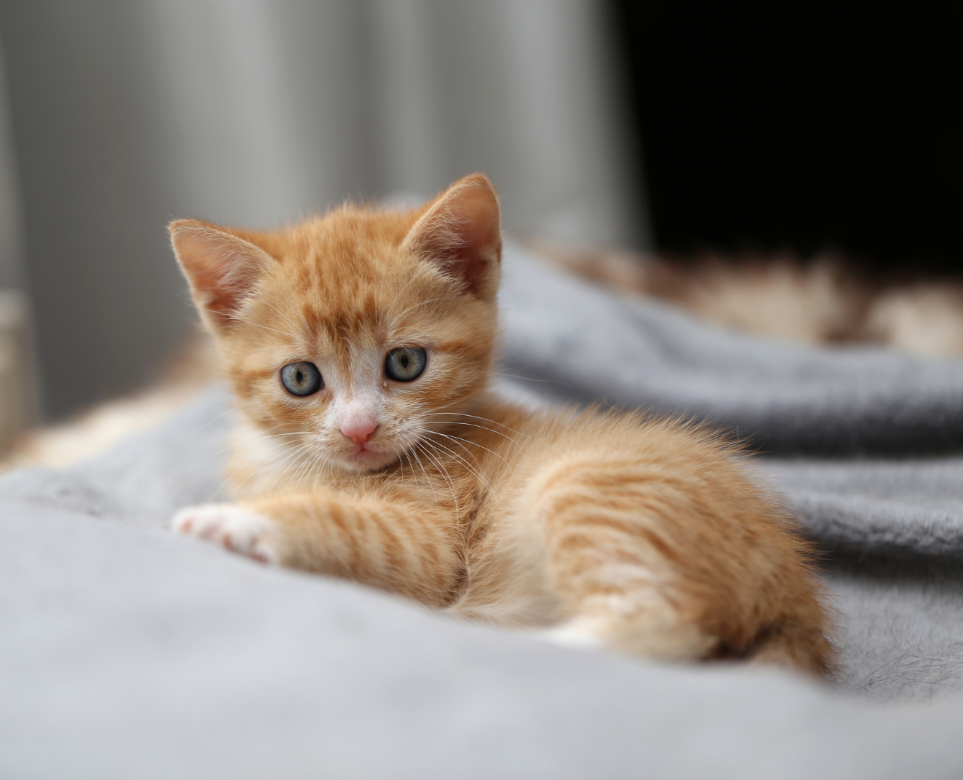
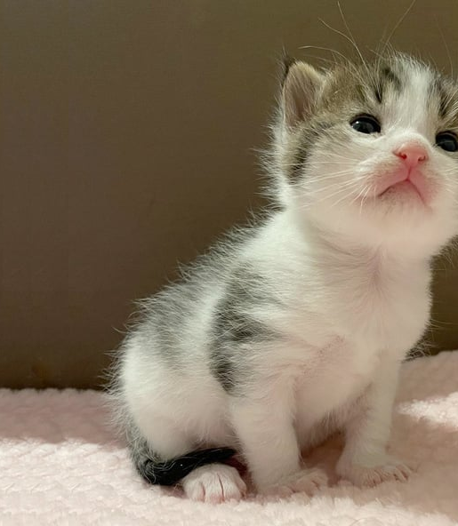
Using uncensored/jailbroken models

Slide 8
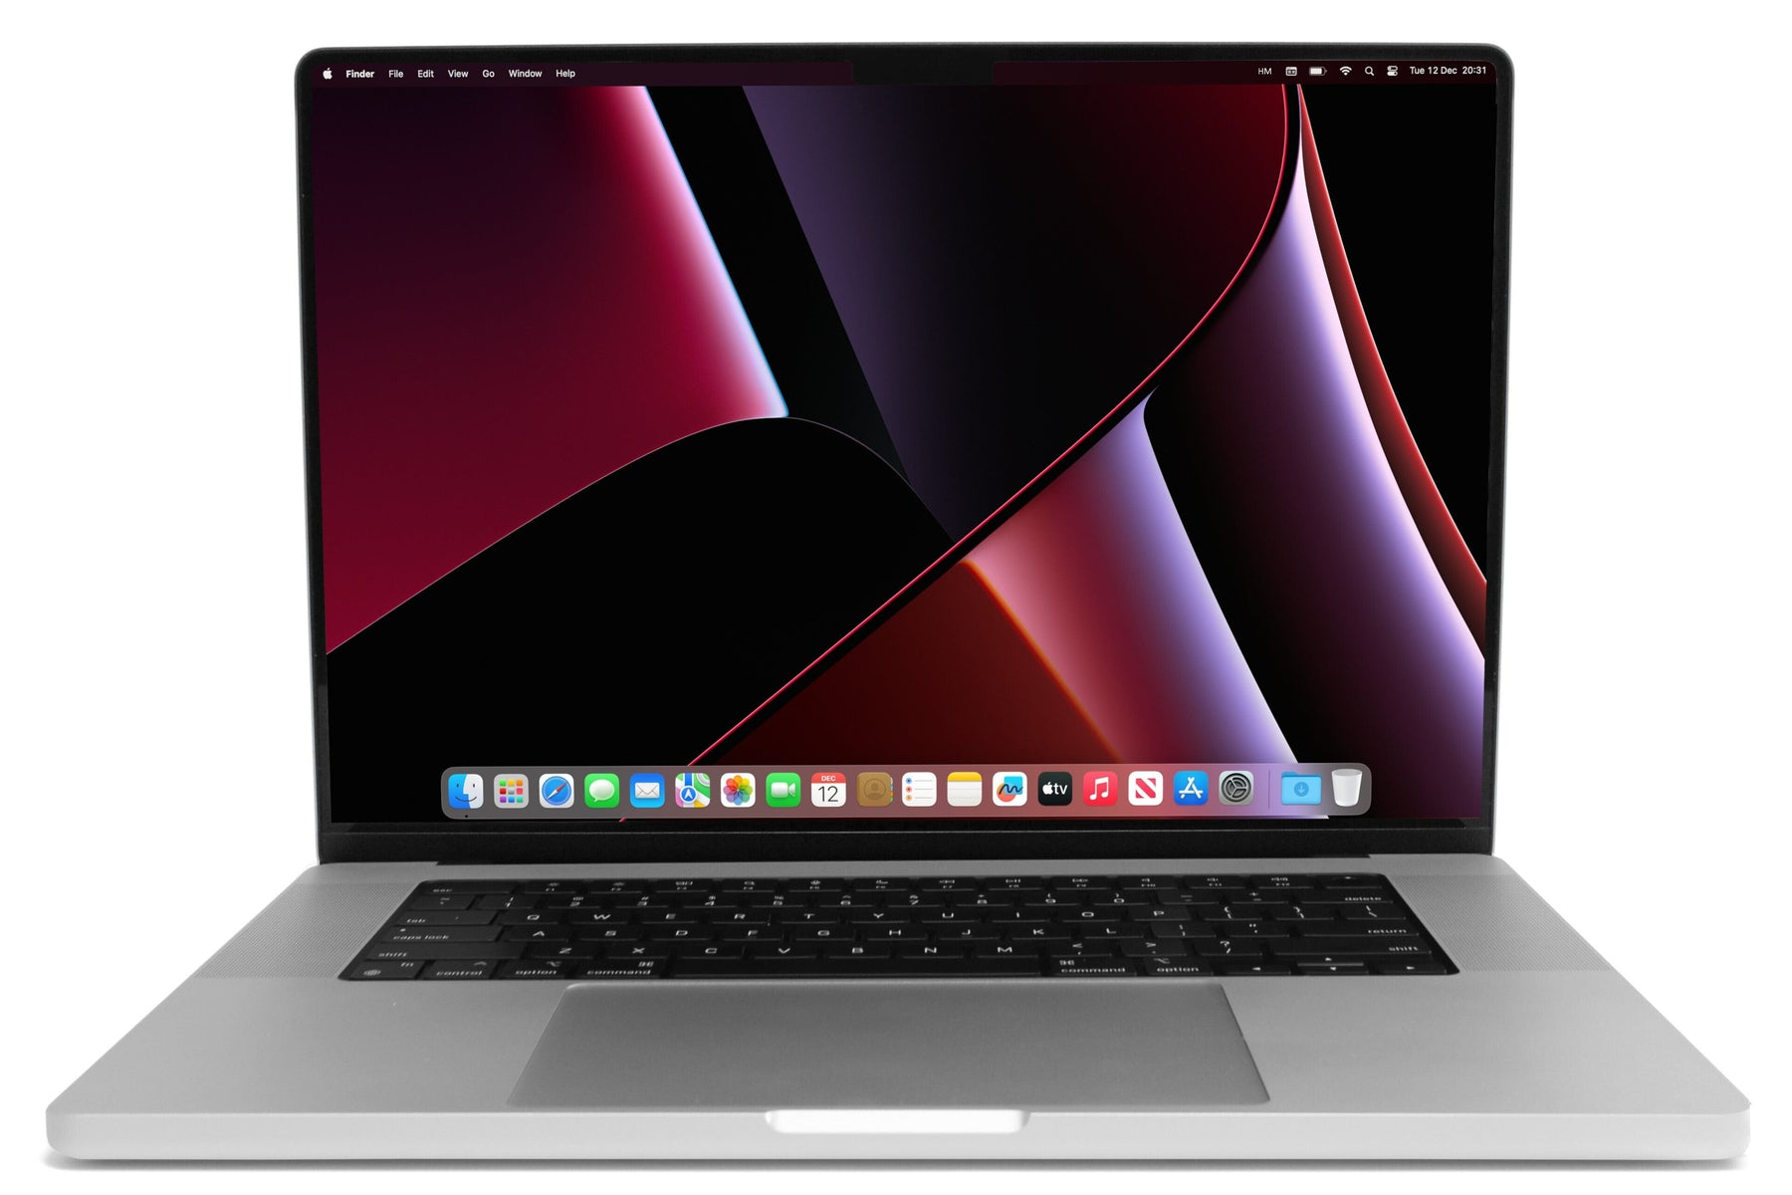
System requirements
I’m using an m2 with 64GB RAM and 2TB HDD
32GB RAM

Slide 9

Key terms
Parameters
Tokens
Context length
Temperature
Modality
Abliterated

Slide 10

Parameters

Slide 11
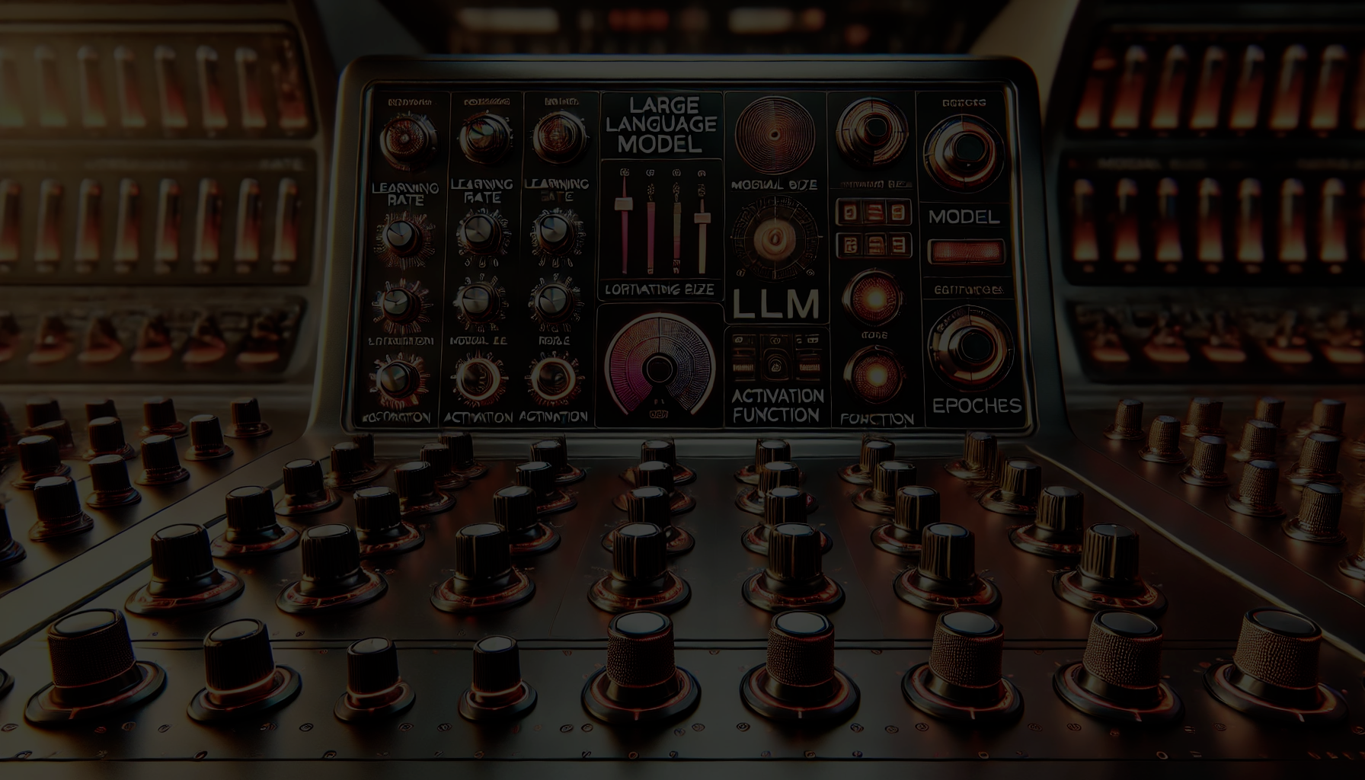

Parameters
When discussing Large Language Models (LLMs), the term "parameters" refers to the number of learnable weights or connections within the neural network architecture.

Slide 12

Tokens

Slide 13

Tokens
tl;dr Tokens are the units or building blocks that LLMs use to process language.
Open AI uses "Byte-Pair Encoding (BPE)".
Consider the phrase "Hello, world!".
It's thirteen total characters and ends up being four tokens:
"Hello"
","
" world"
"!"

Slide 14

Context length

Slide 15

Context length
Context Length refers to the maximum number of tokens
(such as words, characters, or subwords) that the model
can consider when generating text or making predictions.

Slide 16

Temperature

Slide 17

Temperature
Temperature Is a output. hyperparameter
that controls the level of randomness or "softness" in the model's

Slide 18
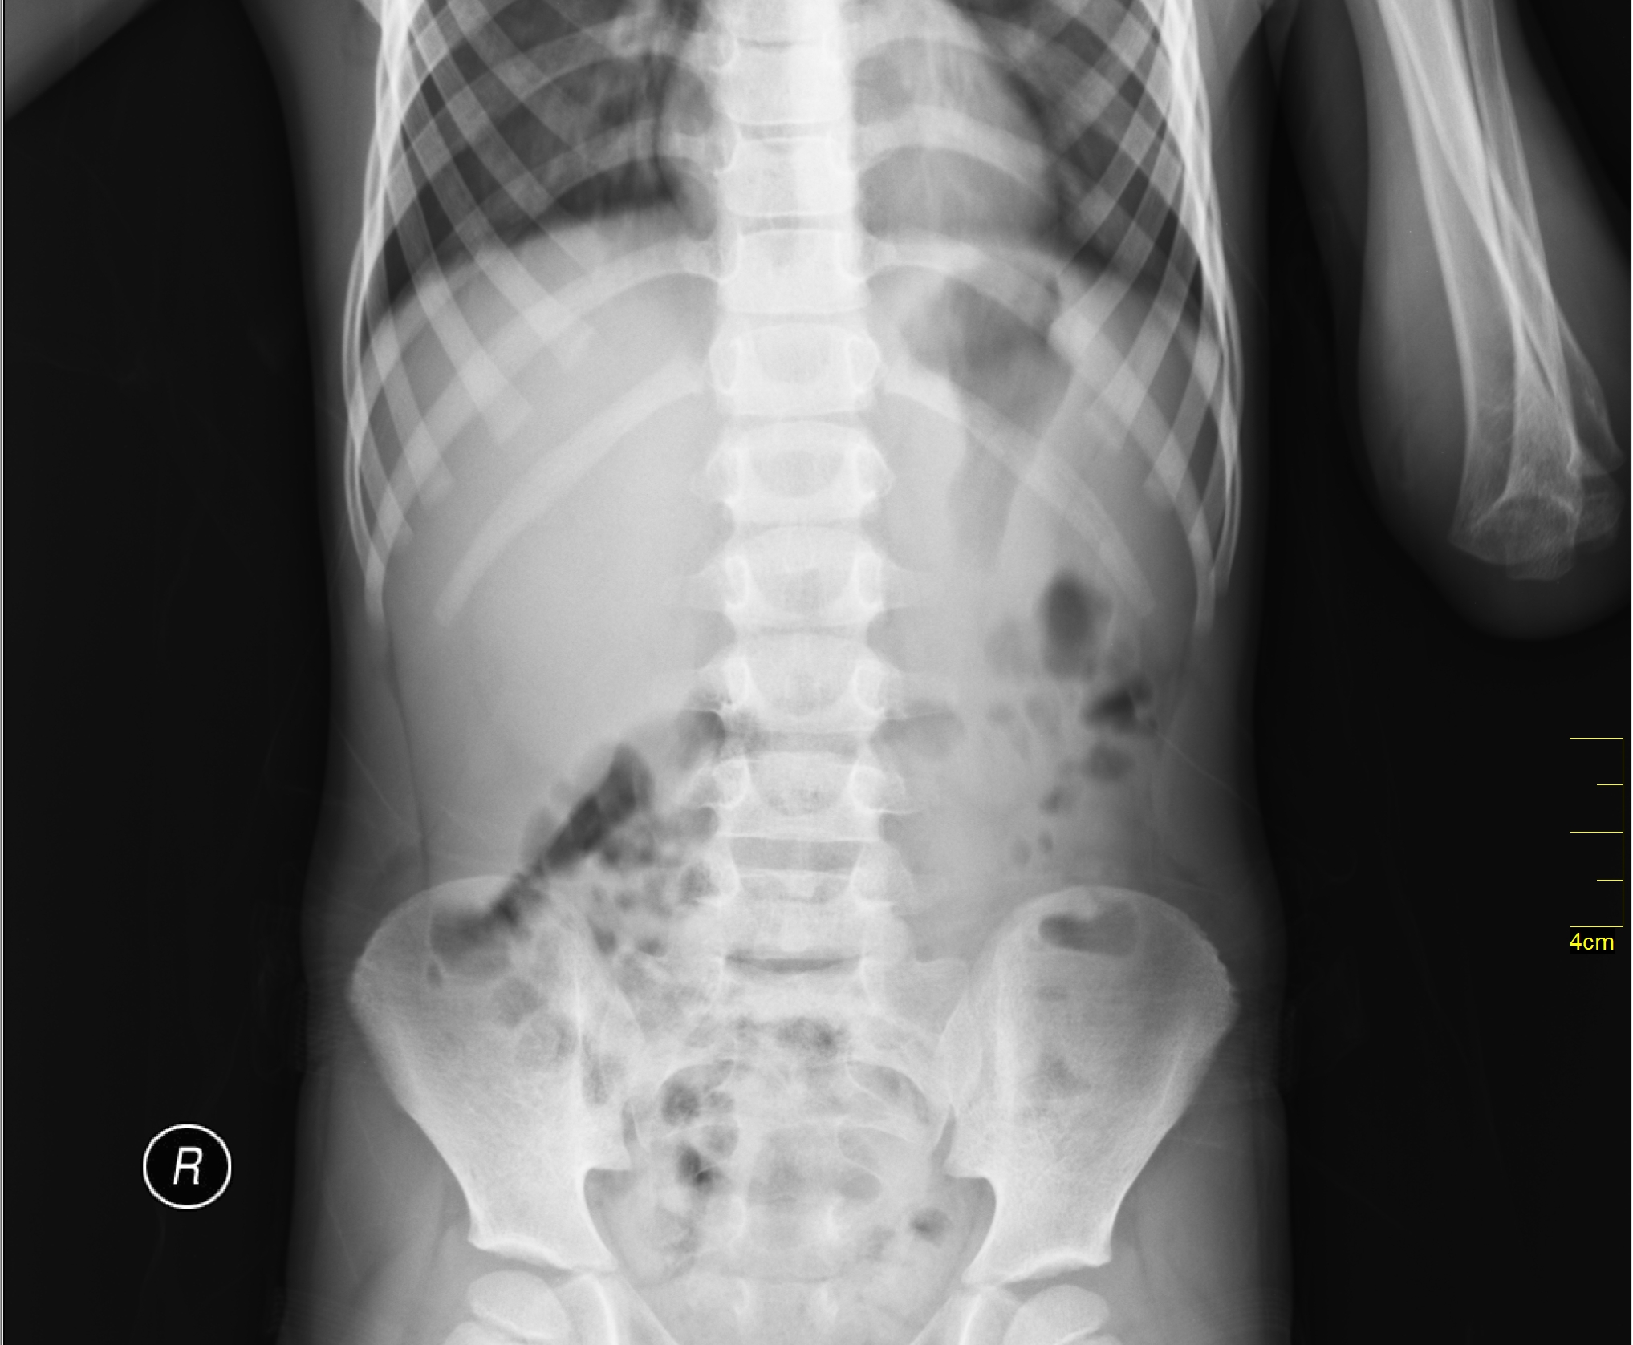

Modality

Slide 19
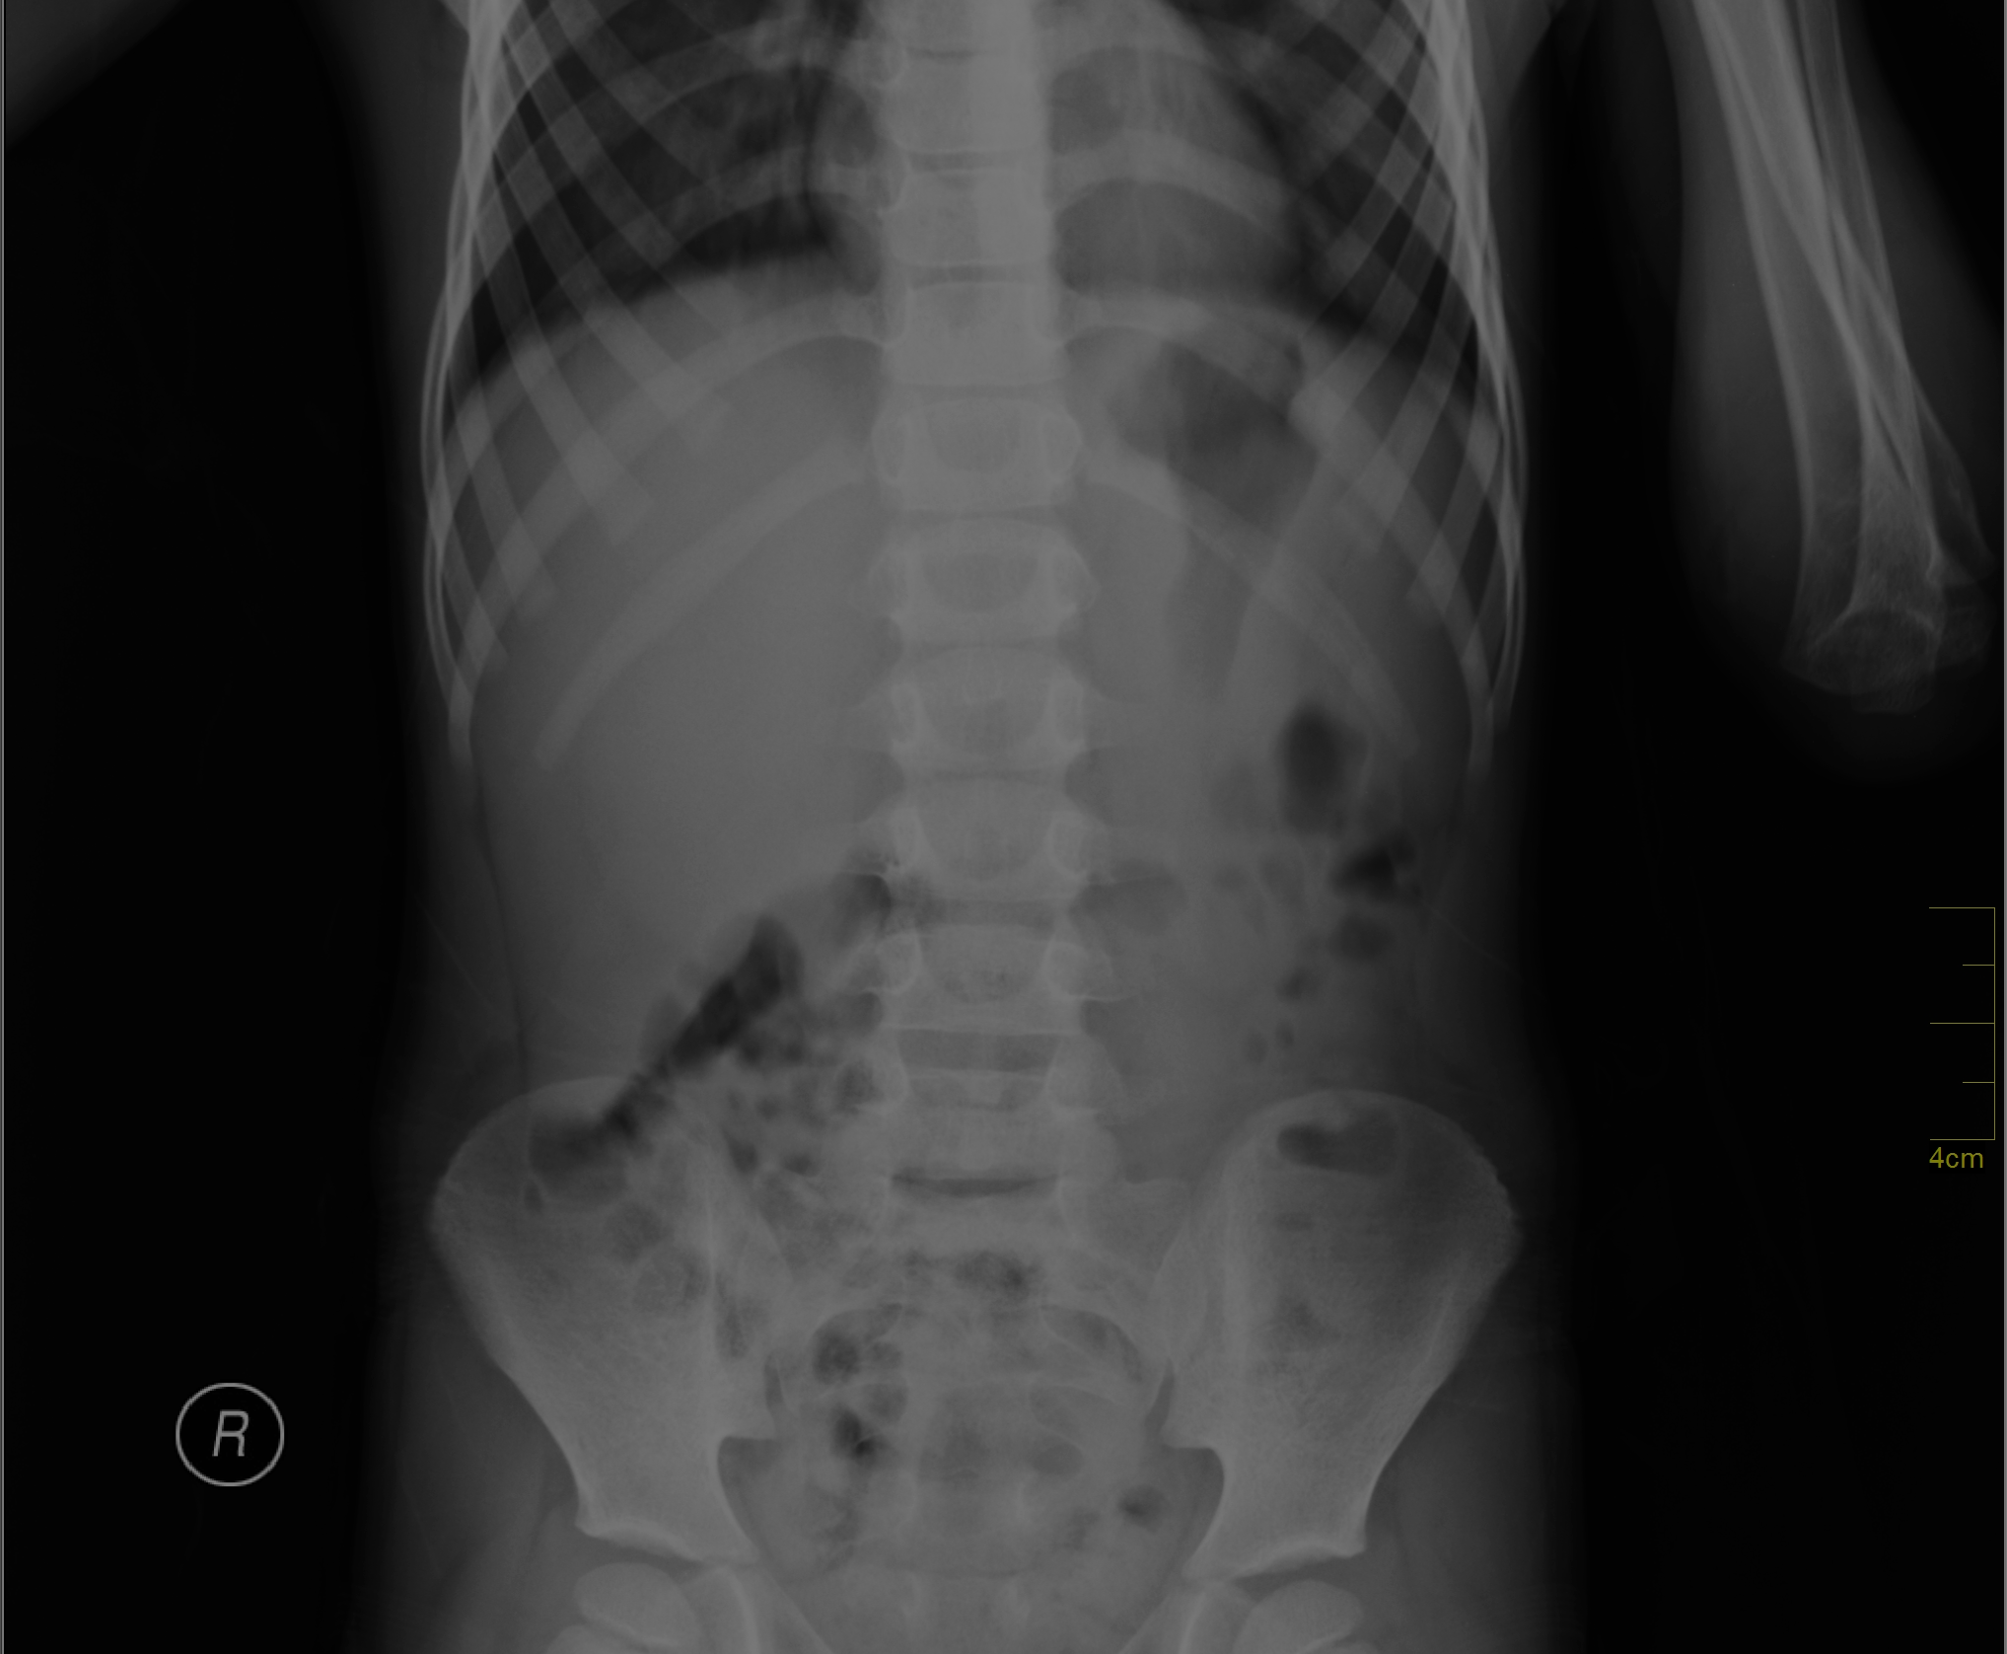
Modality
Modality refers to a type of data input
(like text, images, audio, or video),
while multi-modal models are AI systems
that can process and understand multiple
types of data simultaneously
to generate richer insights
and more accurate outputs

Slide 20
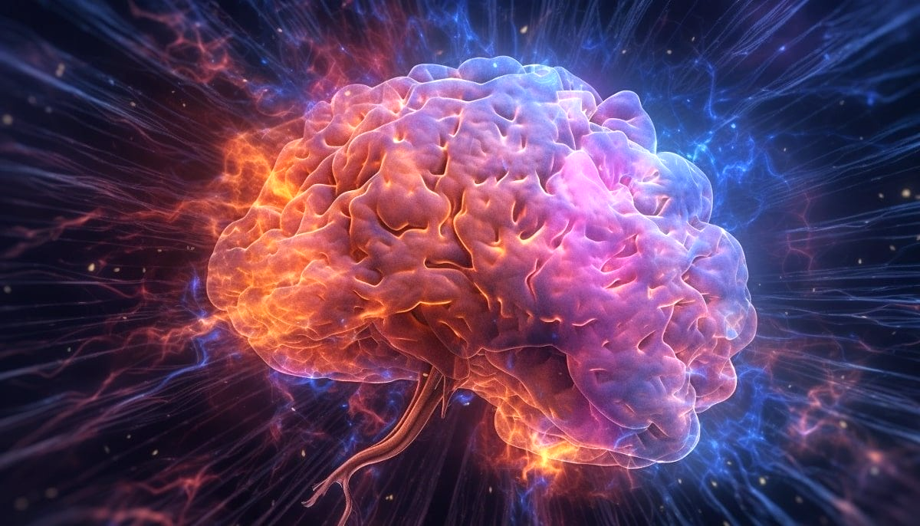
Abliterated

Slide 21
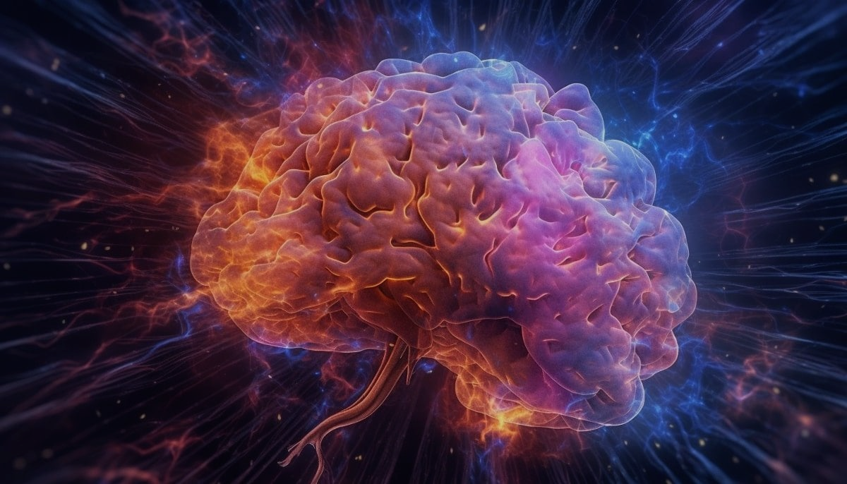
Abliterated
A technique designed to override safety mechanisms in language
models that typically prevent them from responding to certain prompts.
By using "abliteration," users can bypass built-in refusals or restrictions,
allowing the model to answer questions it would normally avoid.
This process involves fine-tuning the model or
manipulating its outputs to reduce or remove these restrictions,
enabling more open-ended and unrestricted interactions.
https://huggingface.co/blog/mlabonne/abliteration

Slide 22
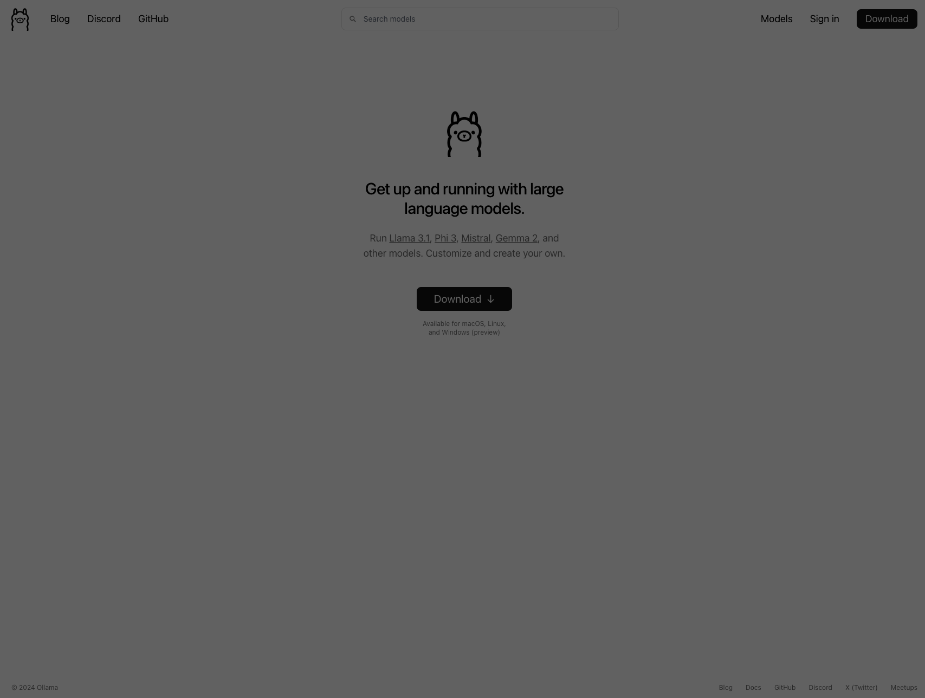
Setup

Slide 23
Setup Local LLM- The easy way
Install ollama
Download pre-trained models
Serve the models
Run the ui
Chat!

Slide 24
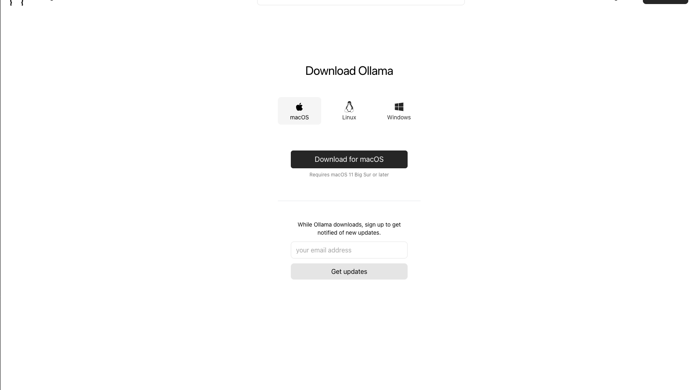
https://ollama.com/download/mac
brew install ollama

Slide 25
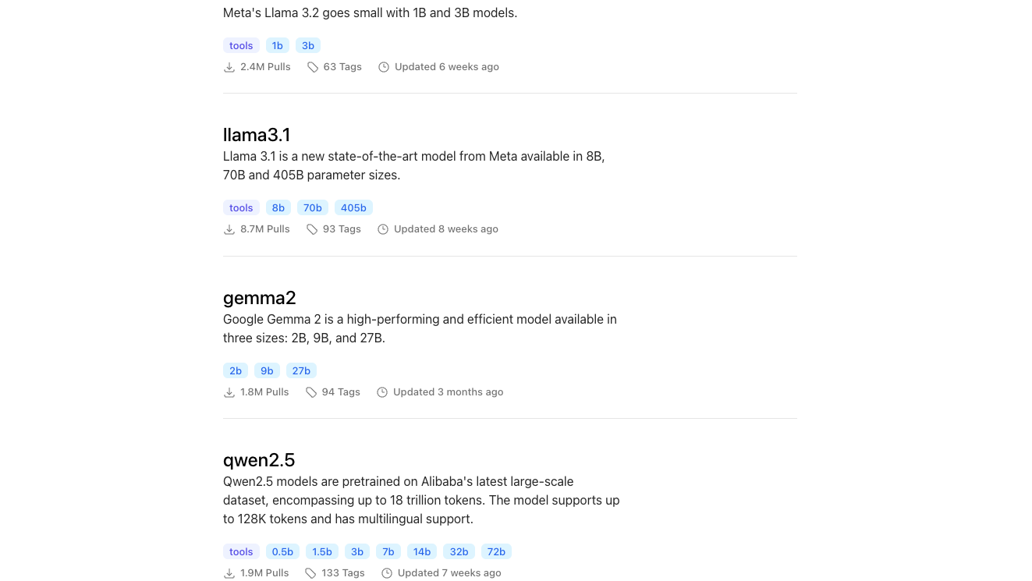
https://ollama.com/library

Slide 26

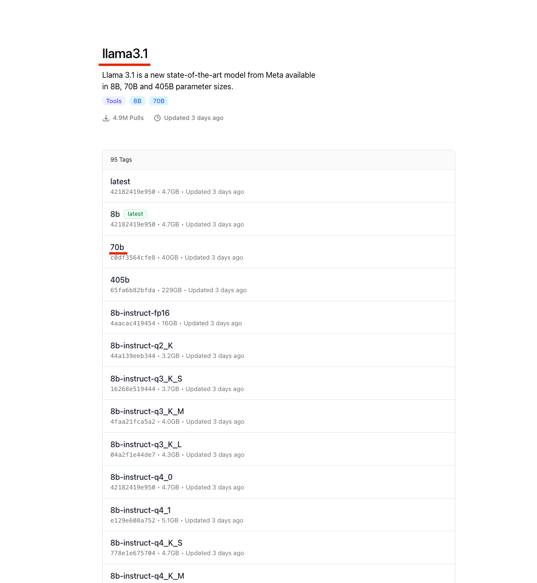
% ollama pull llama3.1:70b

Slide 27
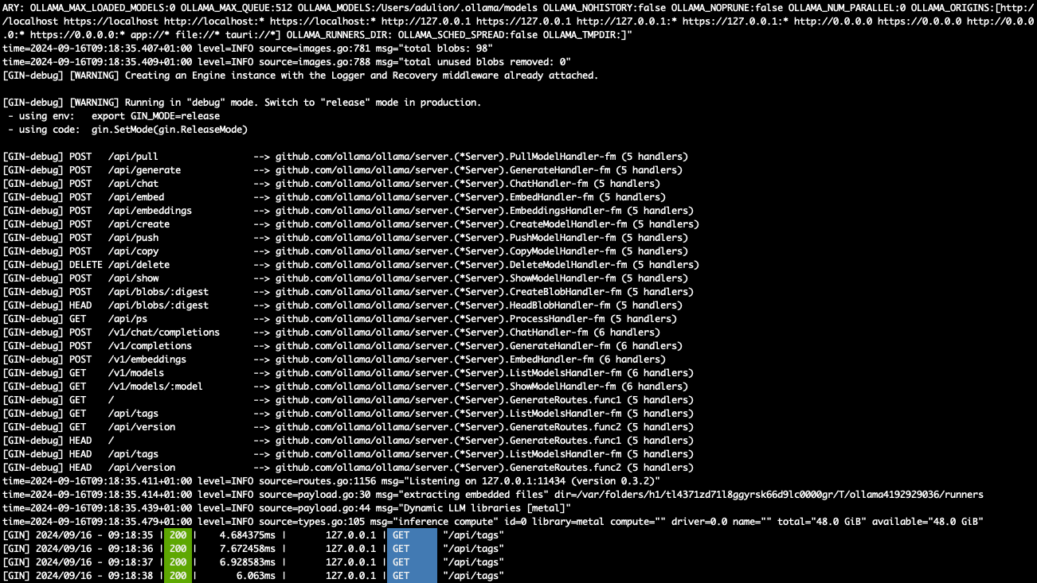
% ollama serve

Slide 28
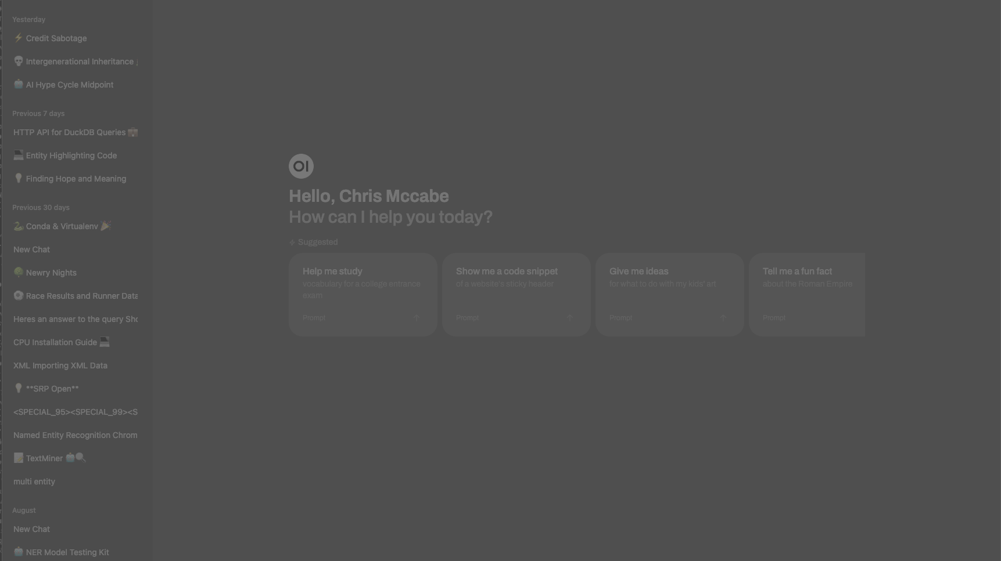
open-webui
% docker run -d -p 3000:8080 --add-host=host.docker.internal:host-gateway -v open-webui:/app/backend/data --name open-webui --restart always ghcr.io/open-webui/open-webui:main
https://github.com/ open-webui/open-webui

Slide 29
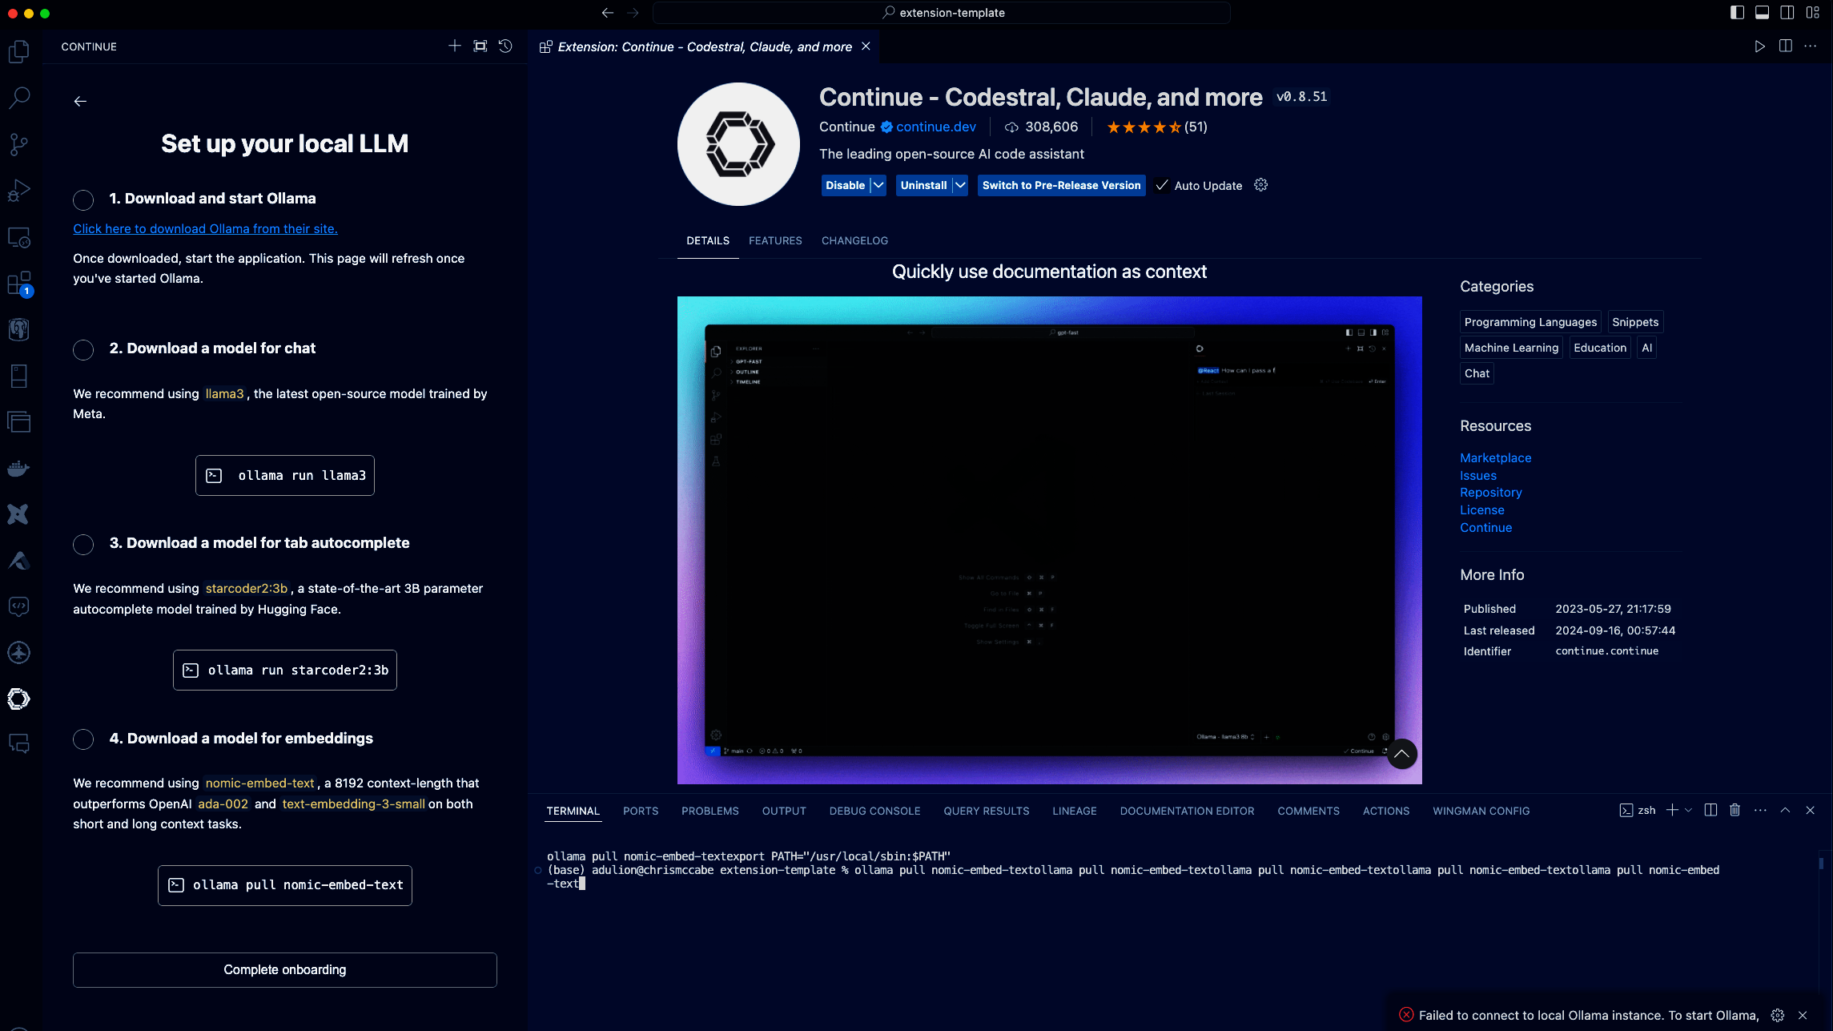
Running your own copilot
https://www.continue.dev/

Slide 30
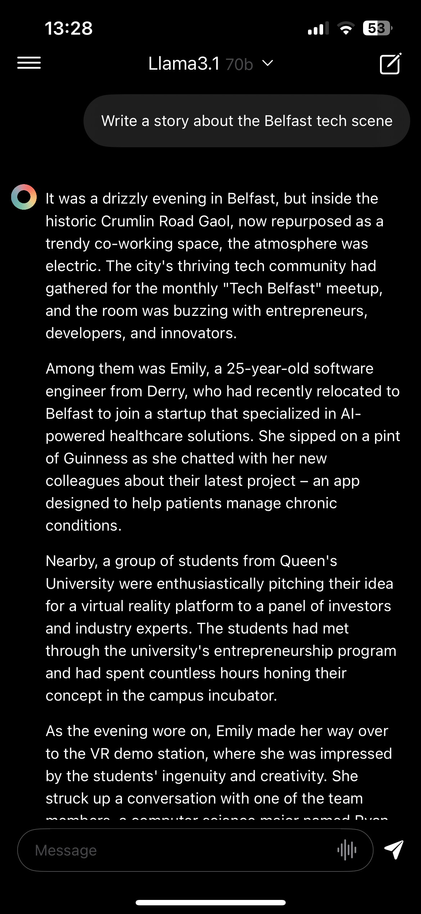
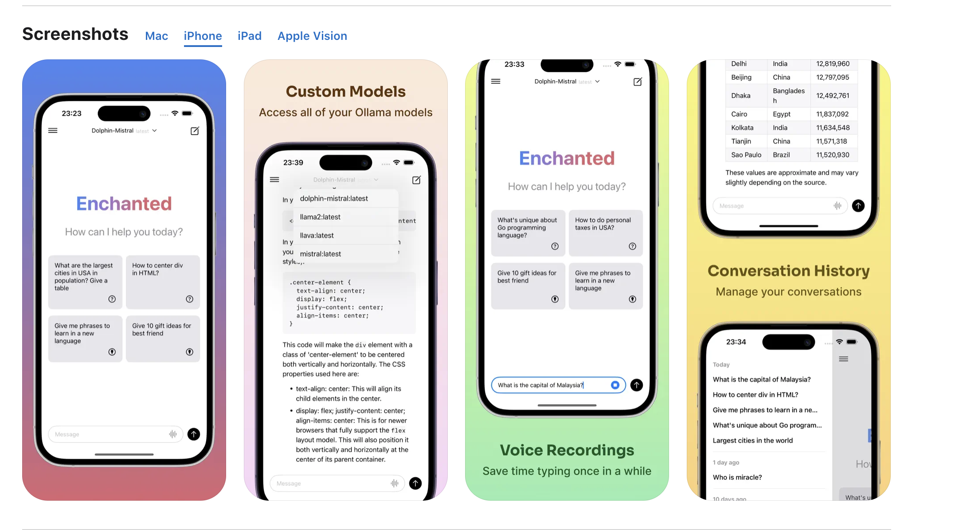

Enchanted LLM

Slide 31
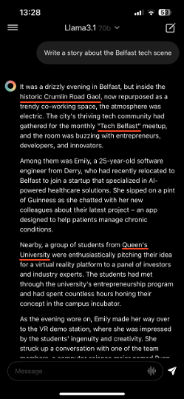
Enchanted LLM

Slide 32

Demos

Slide 33
Reflection
Key terms
Installation of ollama
Serving the UI
Comparisen of models
Using ablirated models
Running Local Model based “copilot”
Replacing openai python calls with Ollama
Using Ollama with langchain
Multi Modal use

Slide 34
Resources
Huggingface
https://reddit.com/r/LocalLLaMA
https://ollama.com

Slide 35


Add me on linkedin
Get the Slides

